Slide 1

Pepper Robot controlled by Kinect in Ubuntu I615E - Robotics
By
1610406 Gao Ziyan
1720413 Shen Zhihao
1820011 Ketchart Kaewplee
1820018 Felix Yustian Setiono

Slide 2
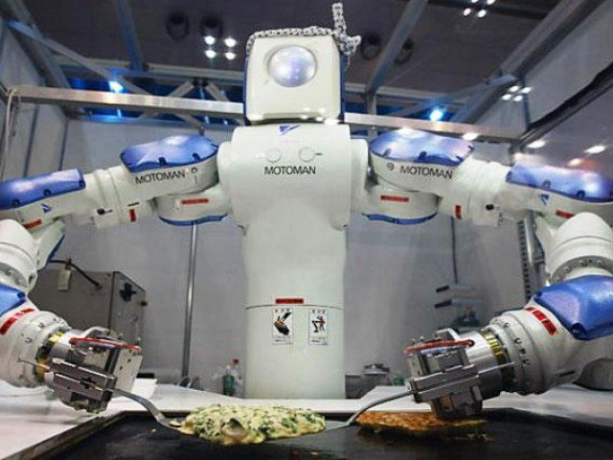
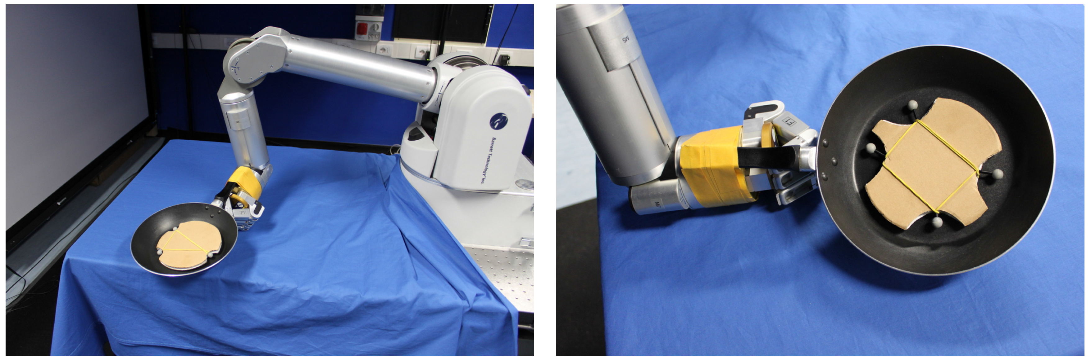
Leveraging Machine Learning for Robotics
Notes:
Service robots will become very necessary in the era that human civilization is high and there is no human in labor work

Slide 3
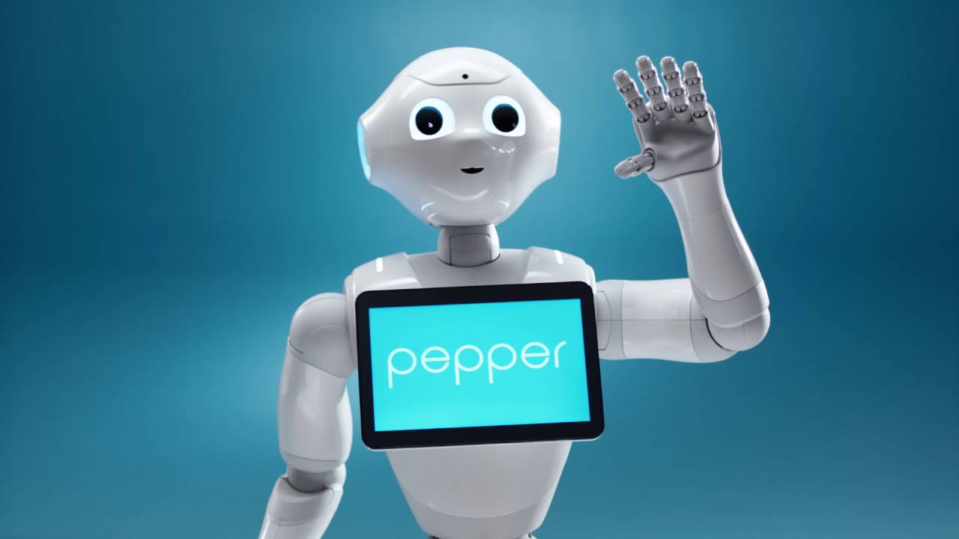
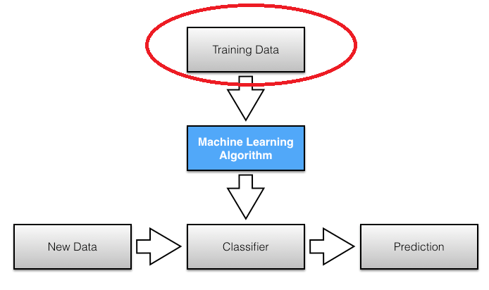
How to implement Machine Learning to Pepper Robot?
How to get Training Data?

Slide 4
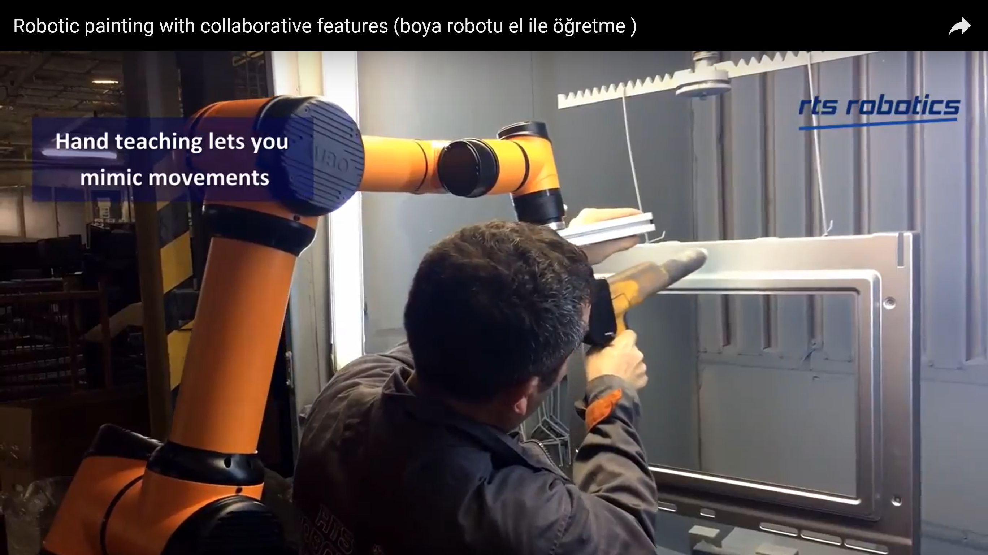
Pepper Robot is not industrial robot.
Hand teaching to mimic movement
Notes:
We cannot pull pepper hand to do learning thing like industrial robot

Slide 5
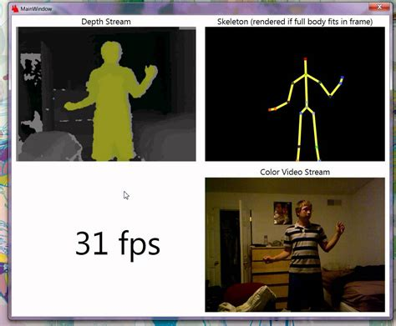
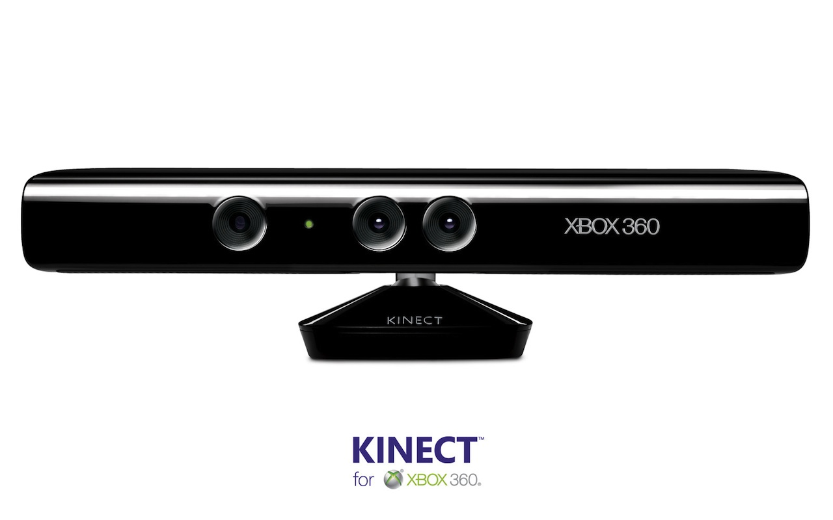
Kinect
Notes:
The answer is Kinect. Kinect camera can predict human skeleton from depth data. With this technology, we can do machine learning easily.

Slide 6
Implementation
Robot : Pepper Robot
Operation System ：Ubuntu
Libraries and tools
- ROS (Robot Operation System)
OpenNI
ROS Kinetic OpenNI
NITE
Openni tracker
Choregraphe

Slide 7
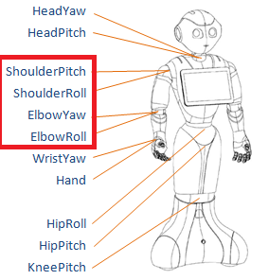
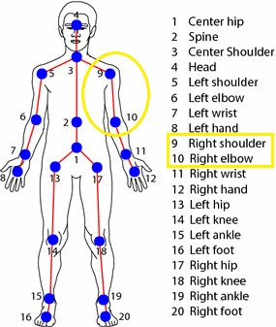
Control
output
input
Notes:
In this project, we focus rotation on shoulder and elbow joint .

Slide 8
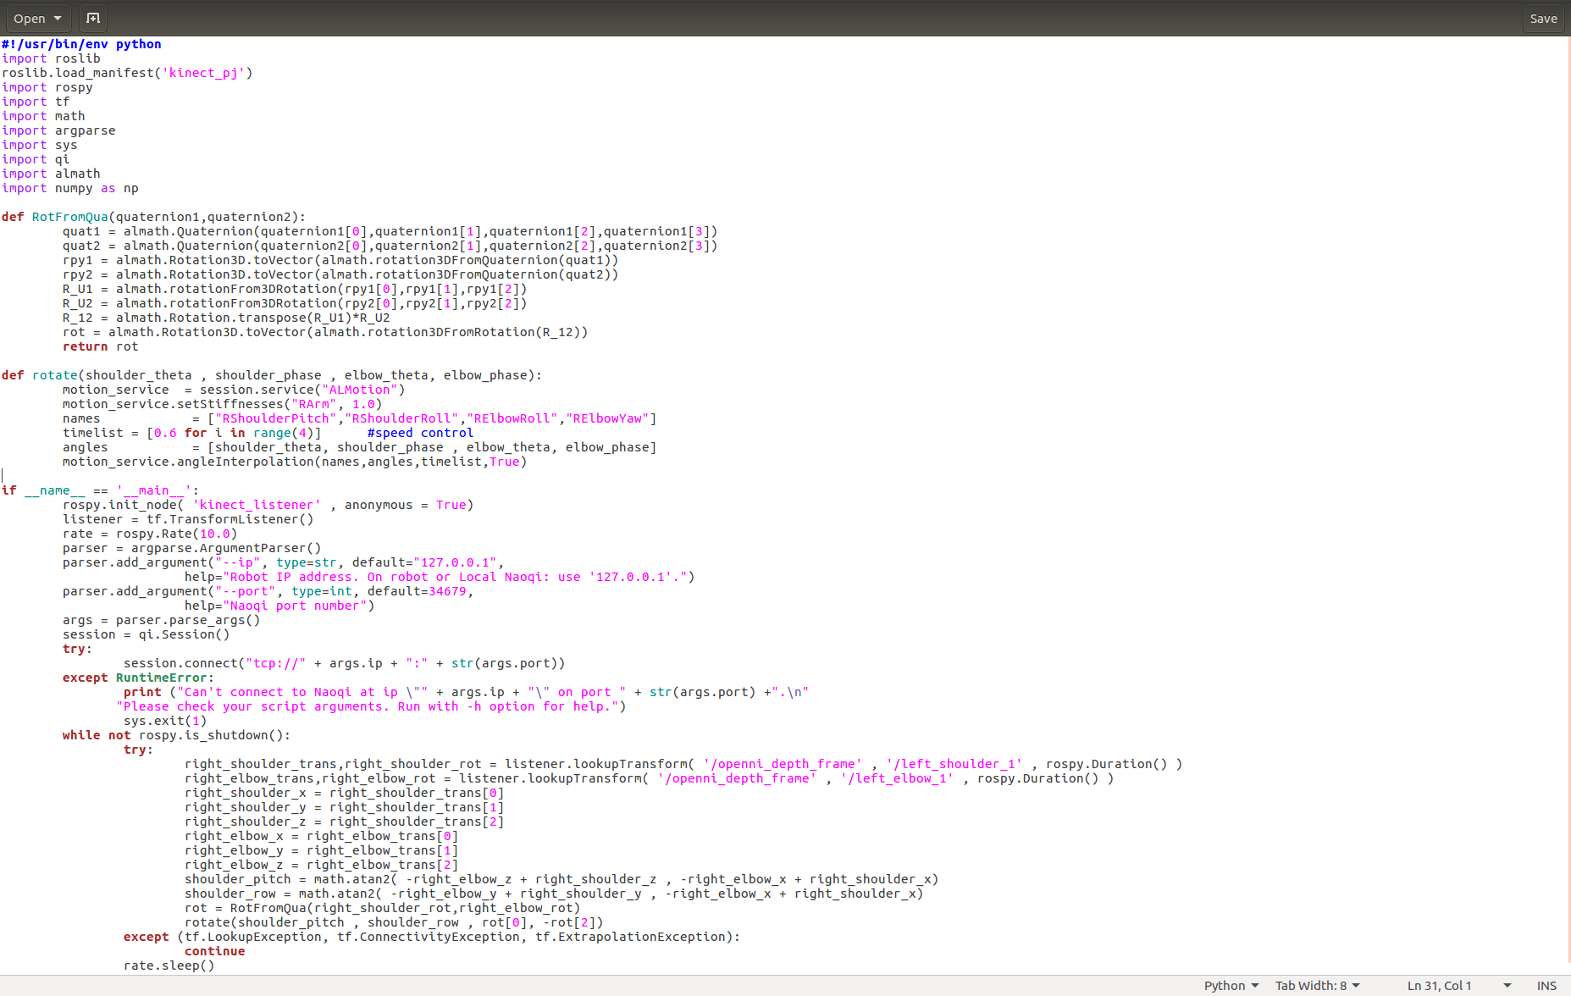
Code
Notes:
In the coding, we have to use knowledge from robotic math. As you can see in the first function, rotation matrix between elbow-to-shoulder come from transpose of rotation matrix of elbow-to-Kinect multiplied by rotation matrix of shoulder-to-Kinect.

Slide 9
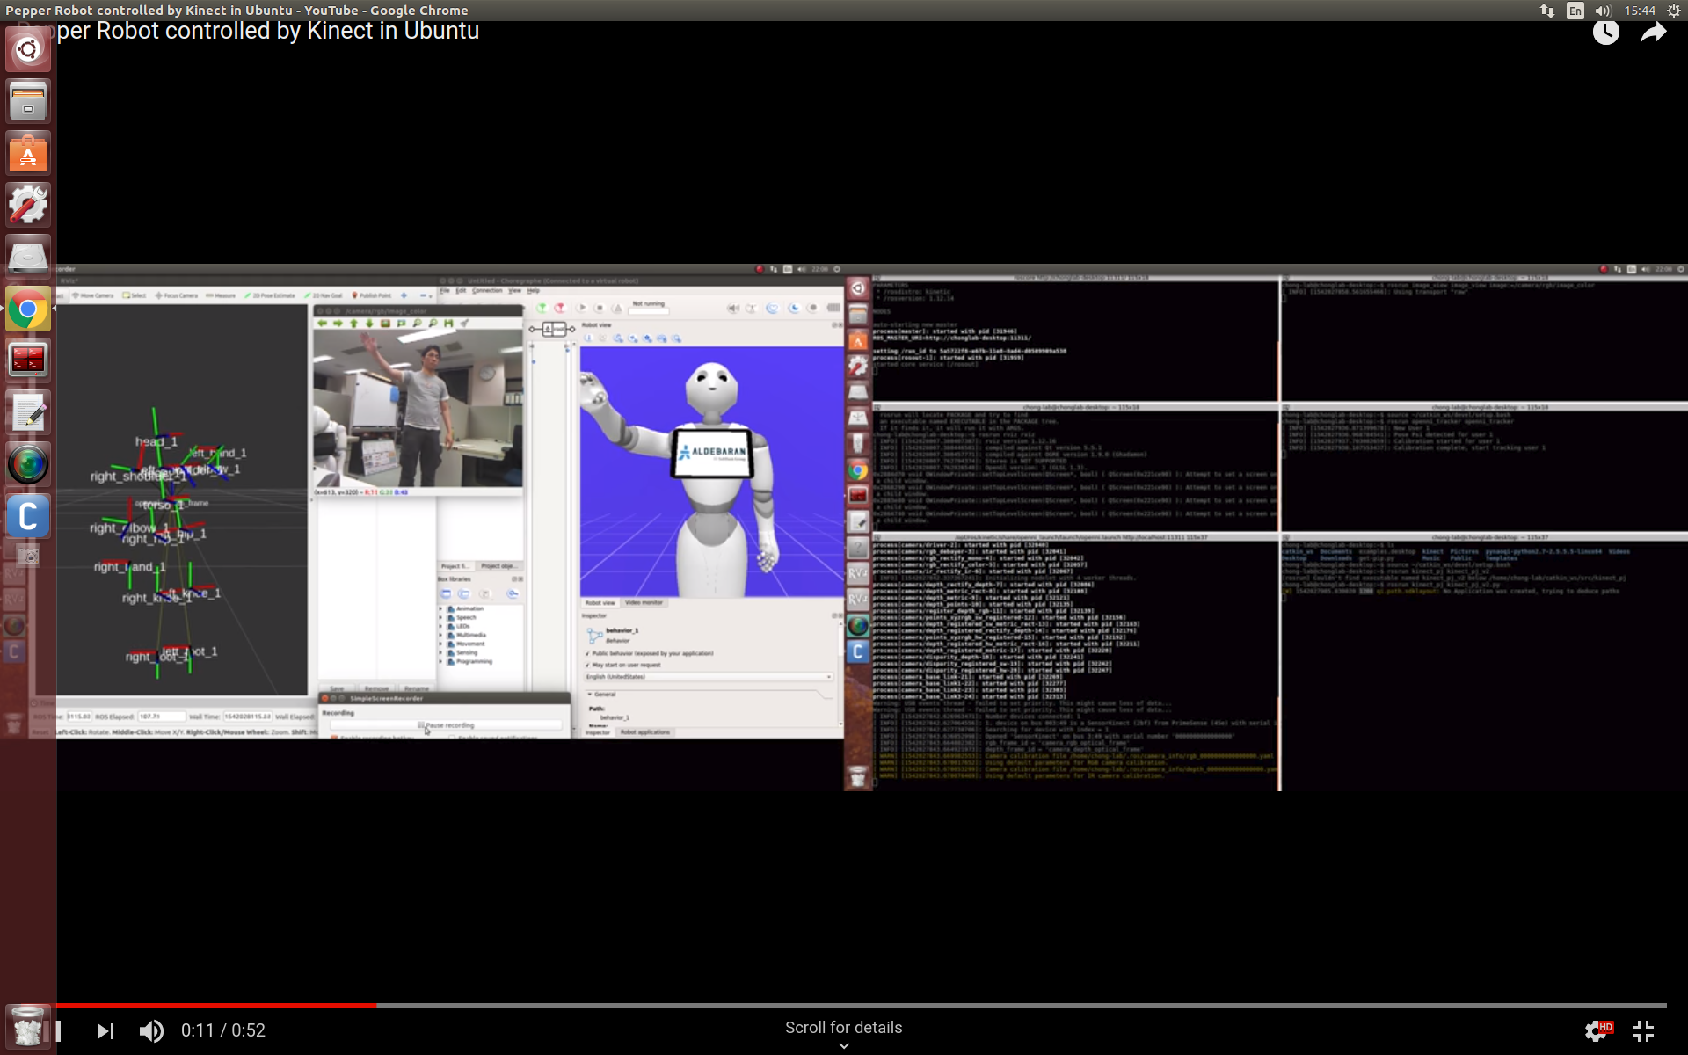
Demonstration https://www.youtube.com/watch?v=OnpqcpGn6u4&feature=youtu.be&fbclid=IwAR37_g8OR28U4-hOuN3O5EtUDm1-Xvou-B532t9FCyN_Vmj3Rwca966uzqo

